Slide 1

RainCheck
An app designed and created by Kyle Goodwin, Alec Rydeen, Jacob Mitchell, and (Liam Costello?)
Group G, CS 518 Fall 2023
Notes:
Author: Creazilla. Creazilla, creazilla.com/nodes/1502598-cloud-with-rain-clipart.

Slide 2
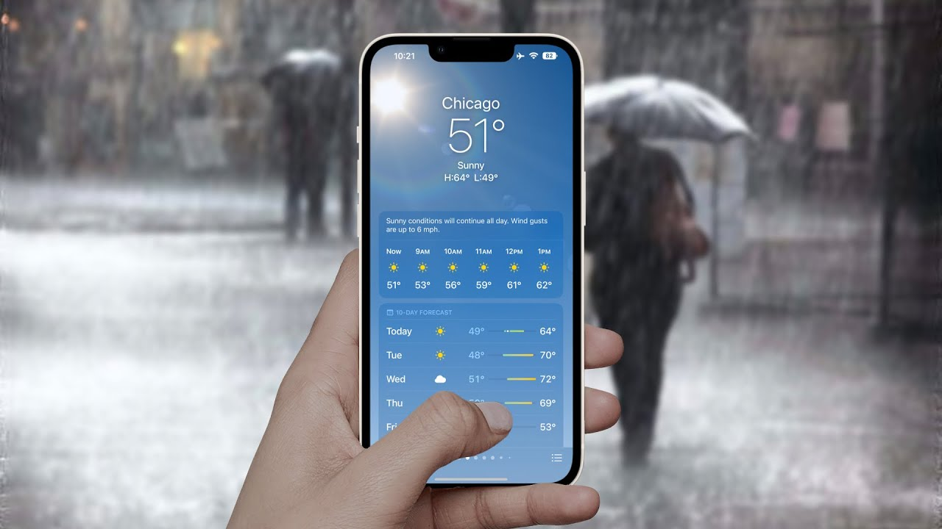
Introduction
Weather apps can be dodgy
What if you could get instant updates?
RainCheck:
Real-time weather and condition
Any location you want
Simple UI and add/view functionality
Notes:
Why iPhone’s weather app is so inaccurate (2022) YouTube. Available at: https://www.youtube.com/watch?v=HtYC2uWIRb4 (Accessed: 04 December 2023).

Slide 3
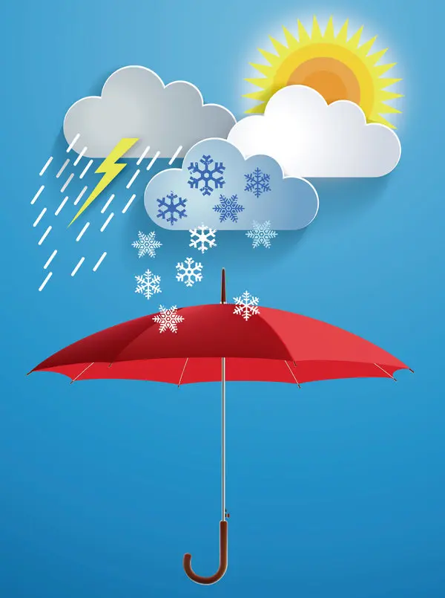
Context
Personal use, though businesses or schools could use as necessary
Getting real-time conditions for different places can be tedious
One-stop shop for all places and activities
Easy to use and understand
Notes:
Wood, Molly. “Searching for the Best Weather App among Weather Underground, Weatherbug and More.” The New York Times, 10 Dec. 2014, www.nytimes.com/2014/12/11/technology/personaltech/in-search-of-the-ideal-weather-app.html.

Slide 4
Requirements
“As an outdoor activist, I want to be able to keep track of multiple locations at once, as I may be planning to hit several different places that day”
“As someone who travels and surfs a lot, I am constantly surfing at different locations that vary greatly. I want to be able to easily check locations that are not close to me, to know if I should travel there”
“As a generally cold person, I want to know the current temperature and wind speed at the ski mountain so I know how much gear I should wear before I go.”
“As someone who is not tech savvy, I am easily overwhelmed by complicated webpages and applications. I would like a weather app that is easy to understand and navigate.”

Slide 5
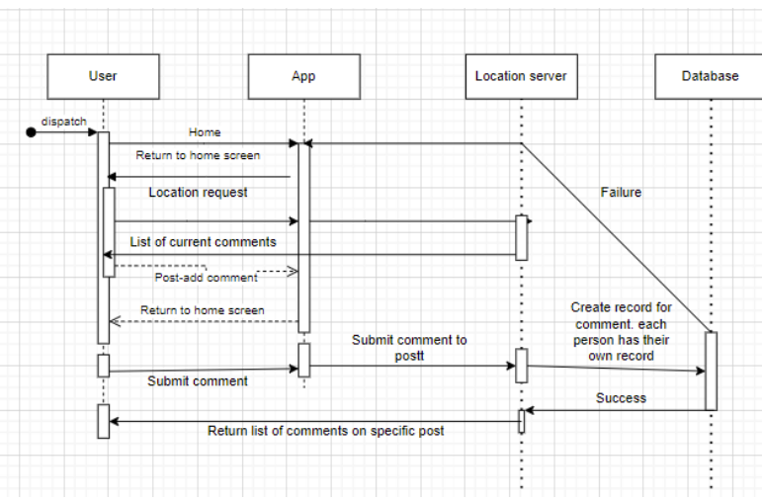
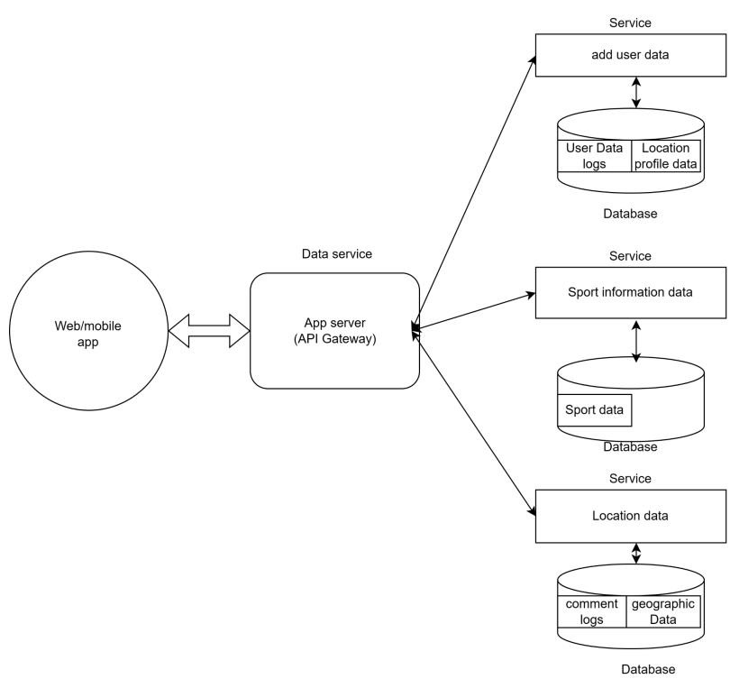
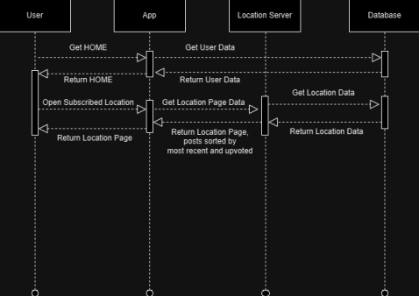
Designs
Sequence Diagram(s):
Architecture Diagram

Slide 6

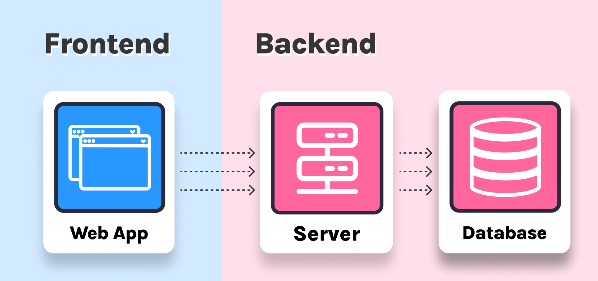
Dev/Testing
Specifications:
Frontend
HTML
JavaScript
Backend
Python
Docker
Azure Functions
Testing:
Unit testing
Lots for azure functions and web app, took us a while to get these working
Different inputs and parameters
Feature/user testing
What does the user think?
Navigation
Notes:
L - H, Jaye. “Frontend vs Backend vs Full Stack: Which to Learn?” Scrimba Blog, 6 Dec. 2022, scrimba.com/articles/frontend-backend-or-fullstack/. Accessed 04 Dec. 2023.
R - “What Is Unit Testing? (Ryo Chikazawa).” Autify, 20 Mar. 2023, autify.com/blog/what-is-unit-testing-ryo-chikazawa/.

Slide 7
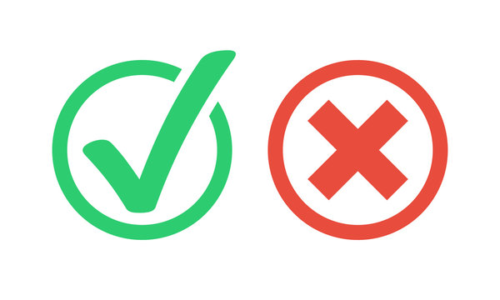
API Functions and returns
Add - Add a new record to the database including location and weather description as parameters
View - Return all records ordered by date and time posted
Delete - Remove records for specified location from the database
All return 200 codes if completed successfully, and 400 codes if failed

Slide 8
Demo!

Slide 9

Takeaways and future planning
Goals/ambitions too big…
Planning in advance is very important
Knowing what you want to do and how you want to do it
Communication!
More features for users
Comments, profiles, upvotes, etc.
Mobile app/support

